Slide 1
Welcome!
Santa Rosa Online Academy
Interest Meeting/Question & Answer Session
2024-25

Slide 2
Who We Are and What We Do
Jerilyn O’Brien– Principal of Santa Rosa Online Academy
Paula Drinkard – School Counselor for Santa Rosa Online Academy
Freda Carroll – School Counselor for Santa Rose Online Academy

Slide 3
What Full-Time Virtual School Options Are Available in Santa Rosa County?
Santa Rosa Online (public school/diploma earning track):
Santa Rosa Online (SRO) (has local teachers using the FLVS curriculum ) (serves grades 6-12)
Home Education (not public school/NON DIPLOMA EARNING TRACK)
Home education students may use Florida Virtual School courses as their curriculum, but will not have local teachers.

Slide 4
SRO Franchise Program at a Glance
Award winning FLVS curriculum
Taught by highly qualified local teachers
Managed locally by Santa Rosa Online Office

Slide 5
SRO Franchise Program Basics
Academic Integrity
Attendance is taken by weekly completion of assignments per pacing guide
Pacing Charts – School Calendar
Modules and Supplemental Activities (ex. Progress Learning, etc.)
Mandatory Discussion Based Assessments
Collaborations
Mandatory Live Lessons and C2 Mentoring sessions with students/teacher
Standardized testing required
Communication with teacher is through phone, email and ZOOM

Slide 6
FLVS COURSEWORK
Students taking online courses must complete all assignments, assessments, and projects with fidelity. No parts of an assignment may be omitted. Unlike traditional brick and mortar school, instructors are not permitted to give a grade of zero for assignments not complete. Students have from Monday morning until midnight Sunday to complete their work for the week. On Monday morning of each week, all assignments not completed per the pace chart in each class will be given a grade of one. Students will NOT HAVE AN OPPORTUNITY TO MAKE THIS WORK UP UNLESS THEY HAVE A DOCTOR'S NOTE. Documents that are submitted blank, will not count as a submission, and will receive a grade of 1. Weekend time should only be used for extenuating circumstances such as illness, family emergency, etc. It should not be a normal occurrence. Students that are consistently behind are subject to being removed from the program.

Slide 8
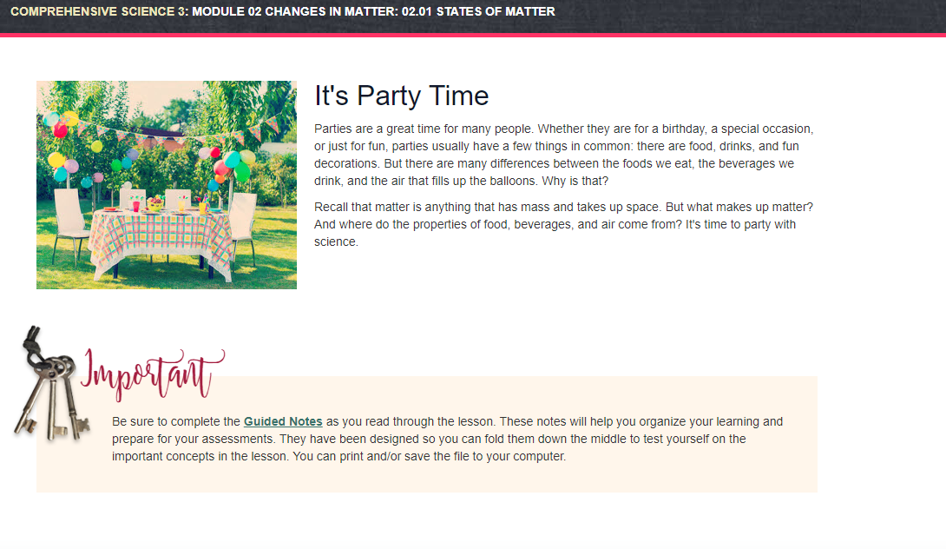

Slide 10
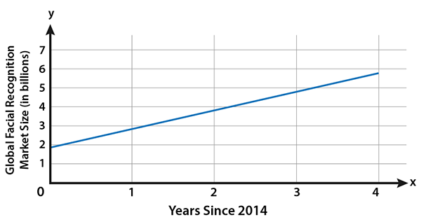
Face Your Predictions
A career in market research involves constructing and studying graphs to determine trends in the data. For example, a linear graph can be sued to determine a growth or decline in sales, which can then be used to predict future sales.
Pretend you are a market research analyst. Can you make a predication based on the graph?

Slide 11
Important Fact to Consider
While full-time virtual school offers several educational benefits, it is not
a good fit for every student.

Slide 12
Online School Misconception:
“Any time, any place, any path, any pace.”
While it’s true that students may access their coursework from anywhere at any time, they MUST submit work weekly according to the pace chart in each course.

Slide 13
Expectations of Students Taking Online Courses
Must have access to a computer with internet and cell phone on a regular basis. Computer needs Microsoft Word(students can get a free copy of this)web cam and a microphone.
Students should contact teacher back within 24 hours
Students should follow their pace charts closely and submit assignments weekly
Students must participate in state assessments 3 times a year. These assessments are administered in person.
If a student is taking an American Sign Lang., guitar, or PE course, he or she must be willing to be videotaped (no exceptions, including IEP)

Slide 14
Tips for success of a Full-Time Virtual School Student
Student has established schedule of waking up at a reasonable time, eating breakfast, showering, and getting dressed
Student has a designated workspace that is clean, well organized and in a quiet location.
Student keeps a work calendar that results in all work getting submitted each week, according to the pace chart in each class.
Student has a laptop or desktop computer. Chromebooks, IPADS Tablets and cell phones are not compatible with some assignments.

Slide 15
Typical Week in the Life of a Full-Time Virtual School Student
Student works one hour per course per day (5-6 hours)
Student school day is typically 8:00 – 3:00. DBA’s must be scheduled during these times
Student schedules Discussion Based Assessments and keeps his or her appointments (approximately 30 per semester)
Student participates in all live lessons and C2 Sessions

Slide 16
Can I work a part time job?
Students can work a part time job; however, they must still complete their weekly assignments on time, participate in live lessons, C2 sessions and schedule their DBA’s during the school day.
Students must also complete a Work Permit form that has to be approved by the district office.

Slide 17
Extracurricular Activities
SRO students may take an elective course at their zoned brick and mortar school such as; Chorus, Band, ROTC, etc. Students must notify their guidance counselor they are doing this and sign up for the course with the brick-and-mortar school.
Students may try out for any sports team that is offered at the brick-and-mortar school they are zoned for. They must meet the grade and GPA eligibility requirements. It is the student and parent’s responsibility to get all the necessary information and paperwork needed from the brick-and-mortar school.
High school students may participate in Dual Enrollment or Locklin Technical College if they meet all requirements. They must have transportation to and from the college to participate in this.

Slide 18
Full-Time Virtual School Works Well for Students Who…
Are motivated and can work independently
Have at least a 2.5 GPA, passing standardized test scores, and have solid reading, writing, and math skills
Are not afraid to speak to a teacher on the phone or on ZOOM
Will discipline themselves to sit in front of a computer and work at least six hours per day
Have at least average computer literacy skills (attaching documents, saving files, etc.)
Have parents/guardians who will monitor their progress and help keep them on track

Slide 19
Full-Time Virtual School DOES NOT Work Well for Students Who…
Struggle to read, write, and do math on grade level
Are procrastinators who must have an adult standing over them to get them to do their work
Are unwilling or highly anxious about interacting with their teachers via phone and text
Are unwilling to sit in front of a computer and work at least one hour per day per class
Have issues attending school regularly. Students who have truancy problems are not any more successful in a virtual school than in a brick and mortar. Parents, if you cannot get your student to attend brick and mortar school, chances are high that you won’t be able to get him or her to do online schoolwork either.
Note: Santa Rosa Online is NOT an alternative school, nor are we proficiency based. Students must complete ALL work to get credit. If a brick and mortar will not take a student based on credits, grades or other deficiencies, neither can we.

Slide 20
Attendance and Pacing:
Because SRO is a public school, regular attendance is mandatory; following the pace chart in each class counts as a student’s attendance.
Students must print the pace chart for each class and follow the charts closely each week.
Students who are behind pace (truant) will be required to report face-to-face at the Santa Rosa Online office to work from 8:30 a.m. until 3:00 p.m. every weekday to get back on track. Students who require this type of intervention will be in jeopardy of being withdrawn from SRO.
Pre-arranged absence requests must be made at least five (5) school days prior to the date of the absence, except in the case of an emergency. Students shall make pre-arrangements for their schoolwork to be done; it will be due the day the student returns to school. Work done in the pre-arranged time allotted will be given full credit. These requests must be made with administration.
Students have from Monday morning until midnight Sunday to complete their work for the week. On Monday morning of each week, all assignments not completed per the pace chart in each class will be given a grade of one. Students will NOT HAVE AN OPPORTUNITY TO MAKE THIS WORK UP UNLESS THEY HAVE A DOCTORS NOTE. Documents that are submitted blank, will not count as a submission, and will receive a grade of 1. Weekend time should only be used for extenuating circumstances such as illness, family emergency, etc. It should not be a normal occurrence.

Slide 21
Schedule Changes and Grace Periods:
Students may not make schedule changes after the first ten days of each semester.
First Semester Grace Period: The grace period ends on Thursday, September 5, 2024. Students must be on pace and passing each course to remain in SRO.
Second Semester Grace Period: The grace period ends on Thursday, January 30, 2025. Students must be on pace and passing each course to remain in SRO.
Communication:
Parents and students are required to maintain close contact with teachers. Students must read all communication from their teachers to benefit from instructional feedback. Phone calls must be returned within 24 hours.
Parents must inform SRO if their contact information changes and update their FOCUS account. Parents and students are required to check email and return phone calls. Consider creating an email for SRO only to easily check.

Slide 22
Academic Integrity/Plagiarism (Not Giving Credit Where Credit Is Due):
Students must do their own work or be penalized for academic integrity according to this protocol:
First Offense: assignment may be redone for a 50/F
Second Offense: student will receive a zero for the assignment
Third Offense: student will receive a zero; all tests must be proctored at SRO office; student will be withdrawn at end of semester and will not be permitted to take any more online courses, per FLVS policy.
Tests will not be reset or unlocked without administrative approval.
All coursework, including links, must be typed and uploaded into the system; no work is to be sent to a teacher via private email, text or in the comment box.
Standardized Testing (Progress Monitoring/FAST/EOC):
SRO students must take all progress monitoring and standardized tests required for their grade level; students who fail to show up for testing may be in jeopardy of being withdrawn. All standardized testing will occur on the campus of Santa Rosa Online, and parents are responsible for providing their own transportation.
Students must present a current photo ID when they report for testing.
For the safety of our students, unless students have parent permission to drive themselves to testing, parents must physically come in to the test site to sign their students both in and out of testing.

Slide 23
SRO/FLVS Assessments:
Please mark these important dates on your calendar for segment exams.
First Semester: All coursework must be completed by 4:00 pm on December 13; all final segment exams must be completed no later than the end of their assigned school day the week of December 16 - 20.
Second Semester (for students in grades 6-11): All coursework must be completed by 4:00 pm
on May 21; all final segment exams must be completed no later than the end of their assigned day the week of May 22 - 29.
Second Semester (for seniors): All coursework must be completed by May 13; final segment exams must be taken by noon on May 16.
Teachers have the prerogative of requiring a student to come to the Santa Rosa Online office to have an assessment proctored.
Students are required to attend mandatory live lessons in all core subjects. Live lessons may meet the collaboration requirement.

Slide 24
Discussion Based Assessments (DBA):
Students must schedule DBAs the appropriate way, using the scheduling tool provided on each teacher’s welcome page or log in during open office hours to complete DBA.
Students who schedule a DBA but fail to keep their appointment at the scheduled DBA time or are not prepared will face the following consequences:
First Offense: contact via email/phone with a warning
Second Offense: 5 points will be deducted from the grade earned when the DBA is completed
Third Offense: 15 points will be deducted from the grade earned when the DBA is completed
Students must complete all DBAs and collaborations required by the teacher for all courses. Students may not opt to take zeroes on DBAs or collaborations.
If a student skips a DBA, he/she may be locked out of the course.
Our full-time SRO students must schedule their DBAs during the school day so our full-time teachers have DBA slots in the afternoons and evenings to offer their part time students who attend brick and mortar school during the school day.

Slide 25
Other Important Policies:
If students choose to take a class at their zoned brick and mortar school, they must notify their school counselor, provide their own transportation, and follow the school’s Code of Student Conduct.
Students must be active in a course for at least 14 days prior to being given a completion grade.
C2 Mentoring sessions are held every Tuesday at 9:00. State required mental health lessons will be completed in these sessions along with other important information and it is mandatory for students to attend.
Supplemental activities will be required for students that are not proficient on PM1 and/or PM2. Parents/students will be notified if they are required to participate in this.
Students must pass each course to remain in SRO.

Slide 26
Mandatory Orientation
Orientation for full time Santa Rosa Virtual Students:
Monday, August 12; Time: TBD
Parent and student must attend.
Session location: TBD

Slide 27
What’s the Next Step?
Parents who feel full-time virtual school would be a good fit for their student should complete the registration paperwork.
Parents new to the district will also need to complete the online registration process on the district web page, www.santarosaschools.org
Registration paperwork should be returned no later than July 31.

Slide 28
What’s the Next Step?
Once we’ve verified that all paperwork is complete, Santa Rosa Online personnel will call you to set up a face-to-face enrollment meeting. Both parent/guardian and the student must attend the meeting.

Slide 29
This PowerPoint presentation can be found on our website at
www.santarosaonline.org
under the “Parents” tab.

Slide 30
THANK YOU
For your interest in Santa Rosa Online Academy

